Slide 1
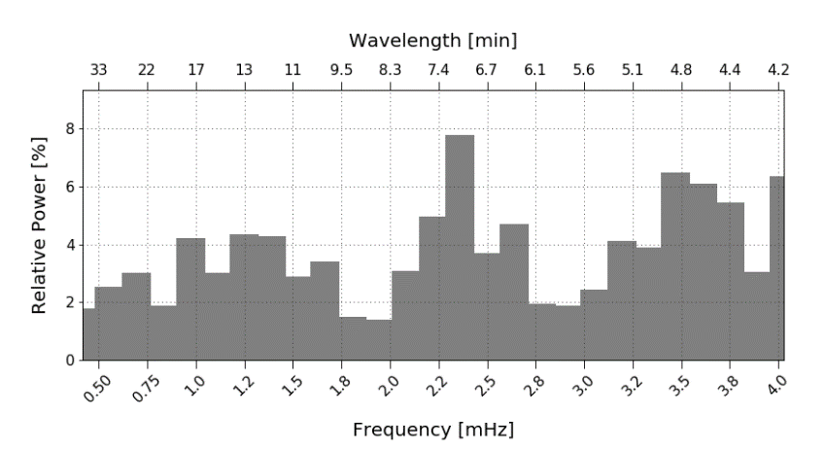
New Features in MeteorFlux
IMC 2024, Kutná Hora, Czech Republic, 19.-22.09.2024
Sirko Molau
Arbeitskreis Meteore e.V. (AKM)

Slide 2
Overview
Motivation
Review of Binning Algorithm
Simulation of Periodic Oscillations
Reference Limiting Magnitude
Application of Population Index
Integrating AllSky7 Observations
Conclusions

Slide 3
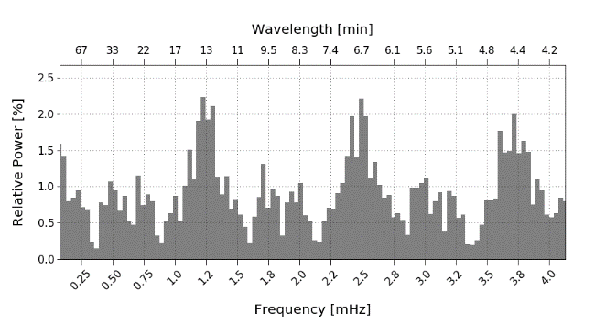
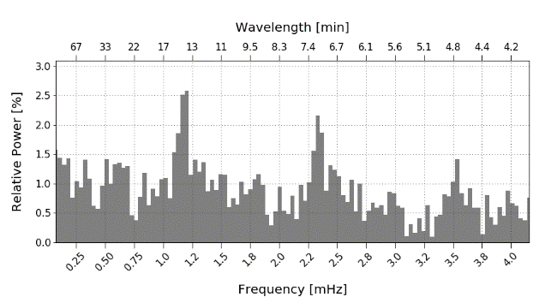
Motivation
Last year I presented results from searching for short-periodic oscillations in flux density profile of meteor showers.
Oscillations during the 1999 Leonids were confirmed.
Periodicity was also found in 2019 and 2020 Quadrantids data.
Two questions were raised:
Quadrantids 2019: 5200 meteors
Peaks at wavelengths 13.6 and 6.7 min
Can these oscillations be a binning artifact?
What is signal and what is noise?
Quadrantids 2020: 2700 meteors
Peaks at wavelengths 13.8 and 7.0 min

Slide 4
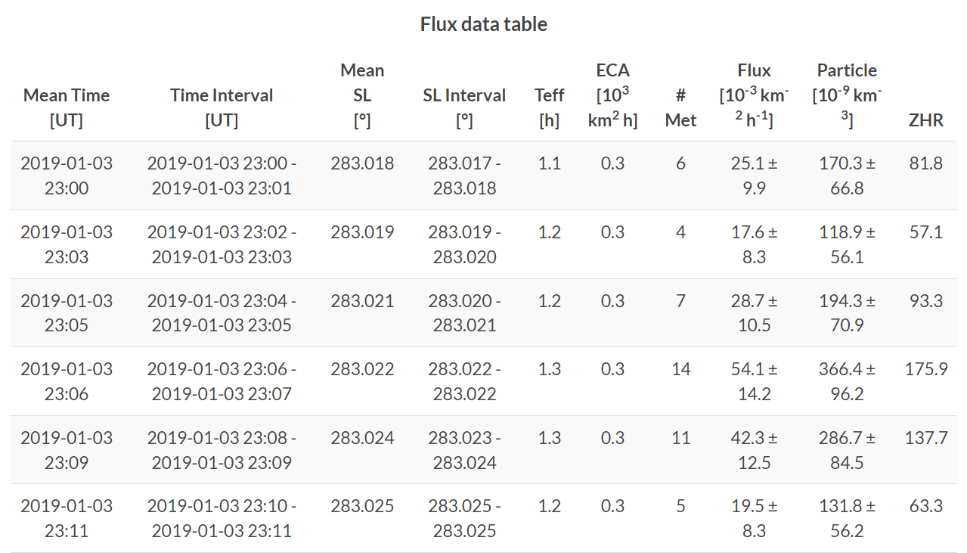
Review of Binning Algorithm
Extension of display to not only show the mean, but also the begin and end solar longitude per interval
The bin size was not constant as required. ☹
MeteorFlux output including interval boundaries

Slide 5
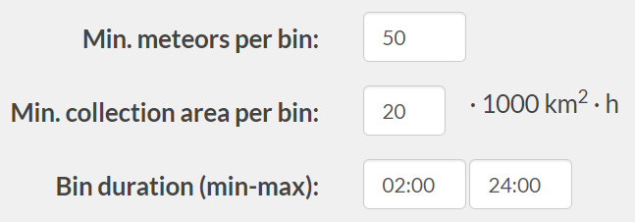
Review of Binning Algorithm
Binning in MeteorFlux is controlled by four parameters:
Minimum number of meteors.
Minimum eff. collection area.
Minimum interval length.
Maximum interval length.
Control parameters for binning
Constant interval length requires min = max interval length.
Binning Algorithm:
Calculate next flux density value from database.
Maximum interval length reached? → Save last bin.
Add new flux density value to current bin.
Min. number of meteors / collection area / int. length reached? → Save bin.

Slide 6
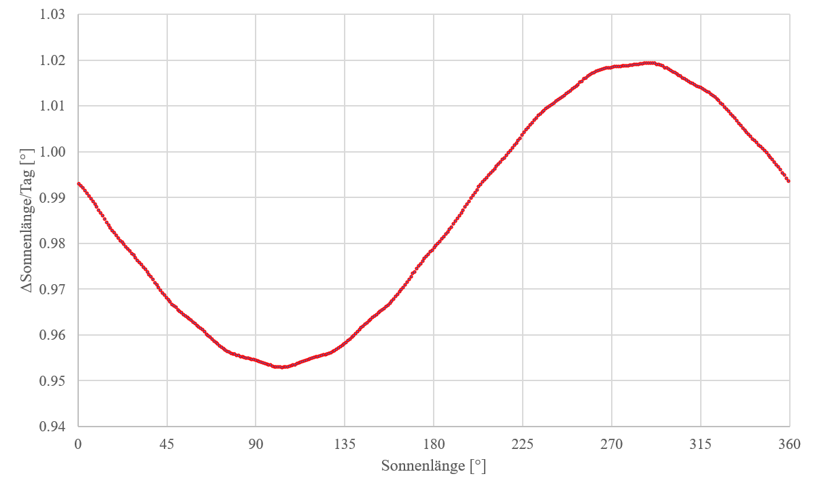
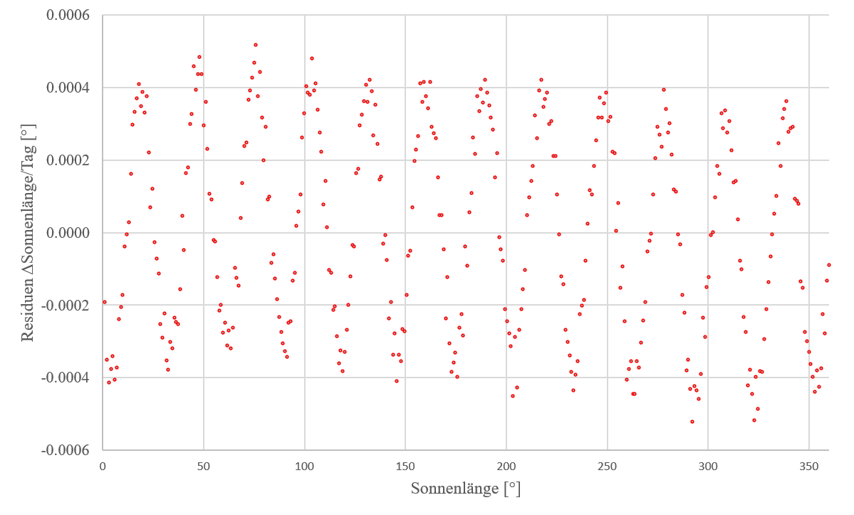
Review of Binning Algorithm
Problems
Several special cases have to be addressed (e.g. flux density measures do not start at begin of interval, gaps in flux density measures, …).
Binning is based on solar longitude, not time (interval length in °SL varies by season, mapping of solar longitude to date is ambiguous, …).
Approximation to transform interval length min → °SL derived:
ΔSL = 0.98616+0.03292 sin(SL+167.5°)-0.00014 sin(2SL+70°)
Length of SL interval during the year
Residual of approximation

Slide 7
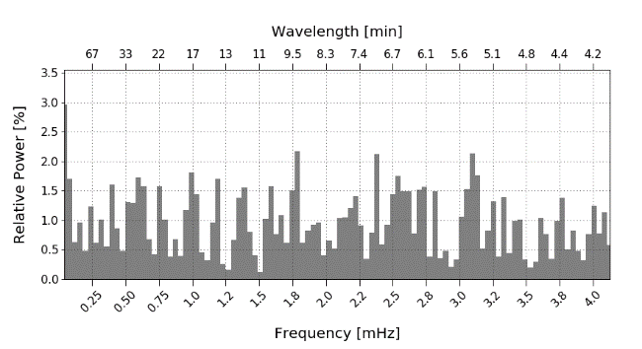
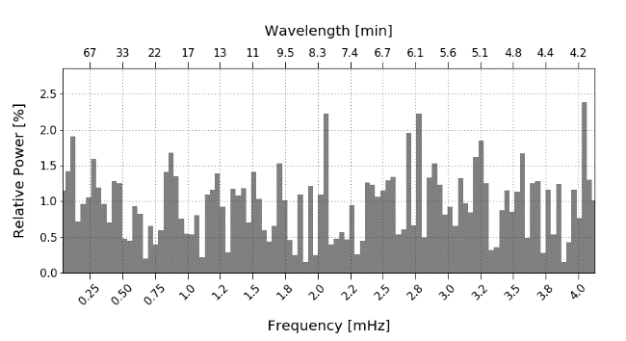
Review of Binning Algorithm
New frequency analysis after the binning problem was fixed.
Quadrantids 2019
Quadrantids 2020
Periodic oscillations of Quadrantids are a binning artifact. ☹

Slide 8
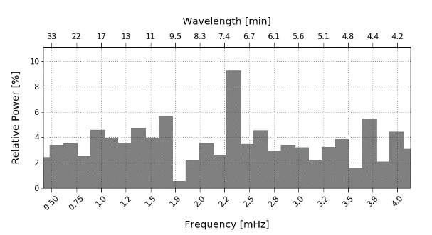
Review of Binning Algorithm
Periodic oscillation of Leonids 1999 remain, but become weaker.
Leonids 1999
What is signal, what is noise?
Simulation of artificial flux density data with known parameters.
Generation of artificial flux density data.
Requires inverse of the distribution function.
Inv. Poisson distribution is non-trivial, but inv. exponential distribution is.

Slide 9
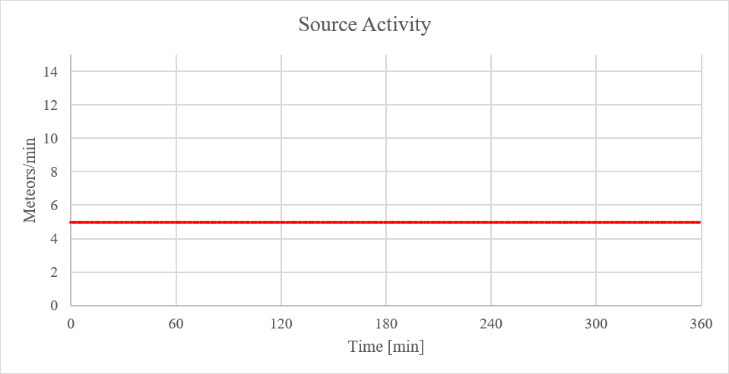
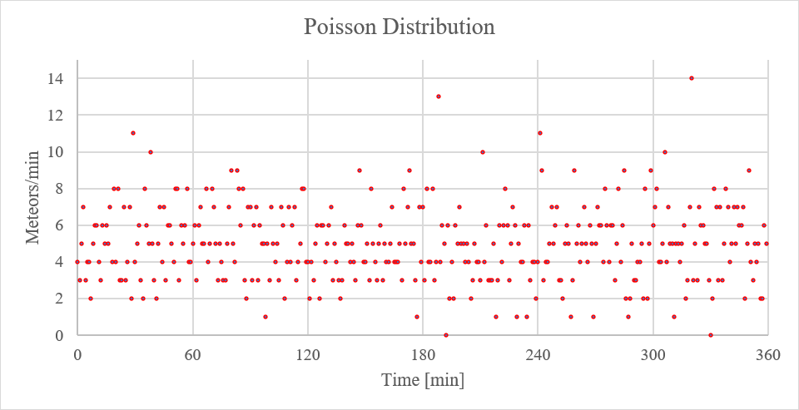
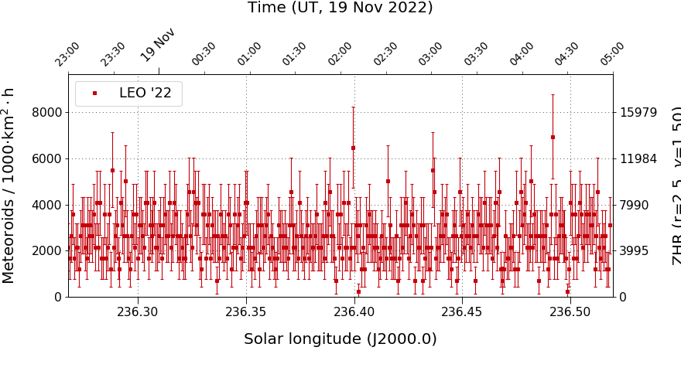
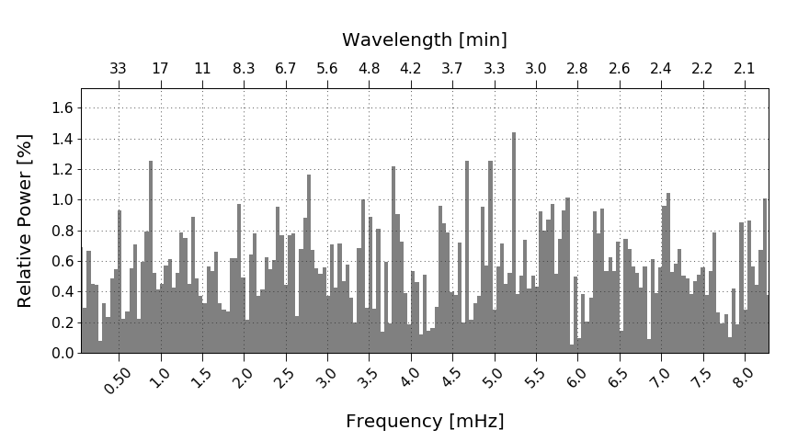
Simulation of Periodic Oscillations
Constant activity without periodic oscillation.
Constant activity 5/min
Poisson-distribution random numbers
Flux density in MeteorFlux
Spectrogram in MeteorFlux
No preferred frequency, just noise in spectrogram.

Slide 10
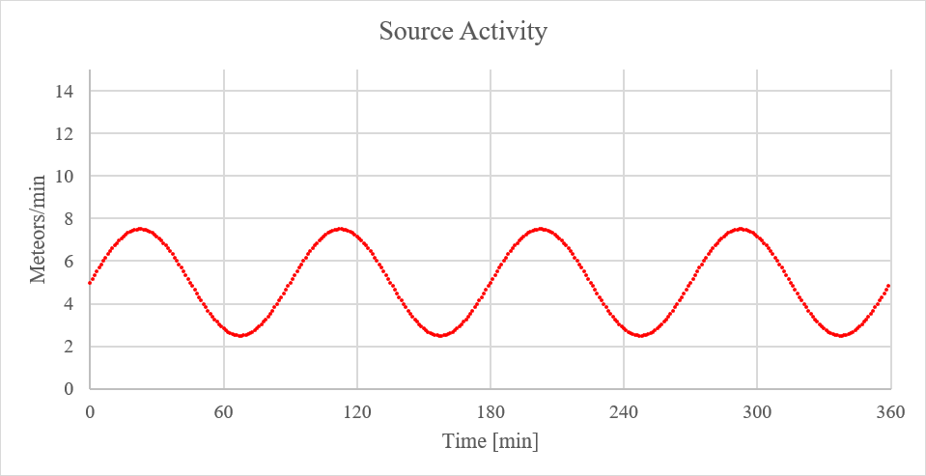
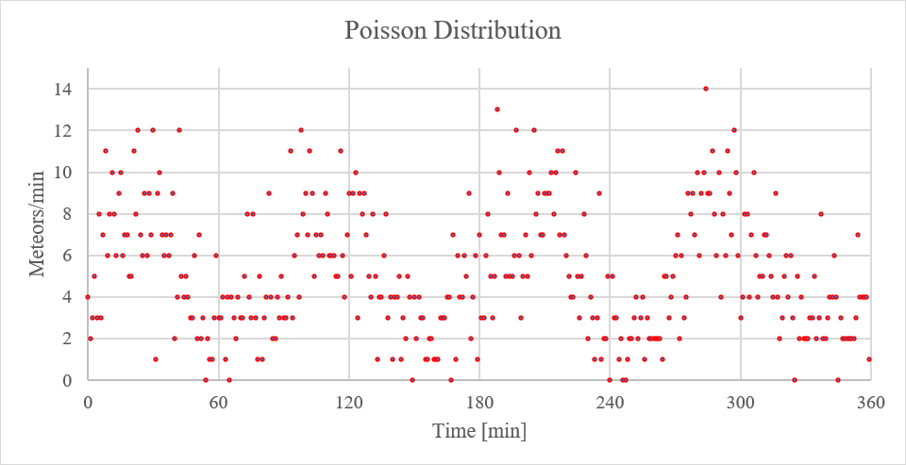
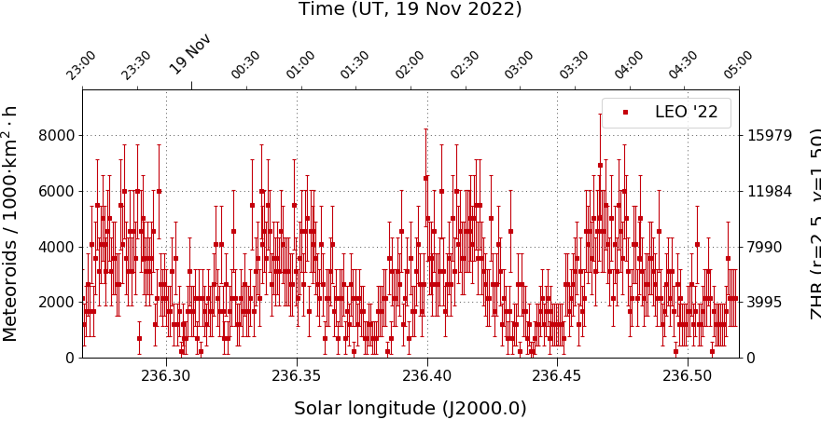
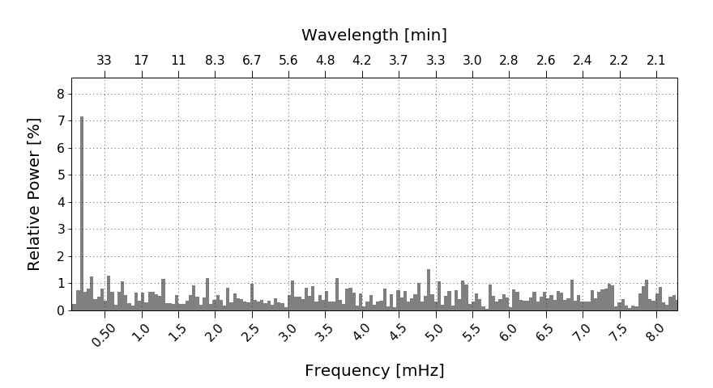
Simulation of Periodic Oscillations
Effect of strength of periodic signal : 2/3 of background
Constant activity 2.5/min + Sine with 5/min and WL 90 min
Poisson-distribution random numbers
Flux density in MeteorFlux
Spectrogram in MeteorFlux
Periodic signal is dominating the spectrogram.

Slide 11
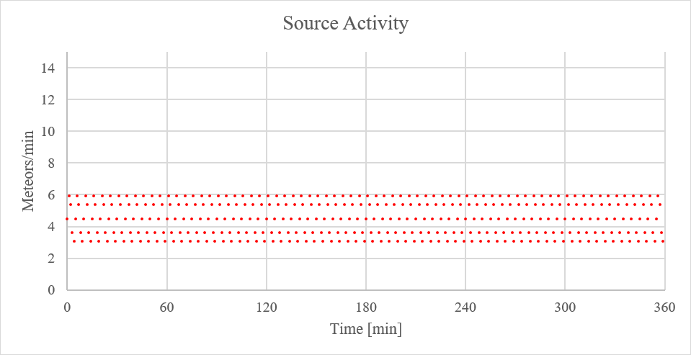
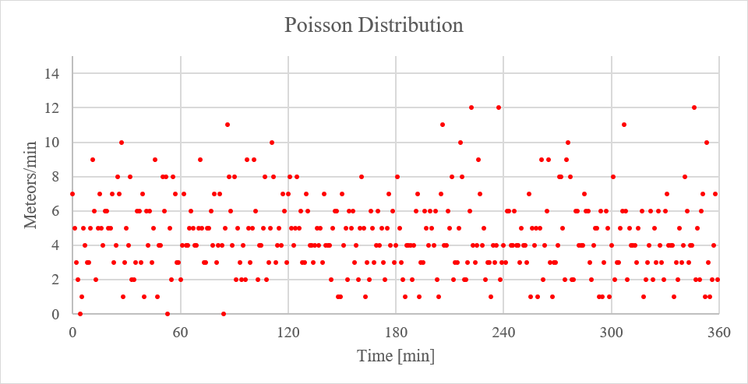
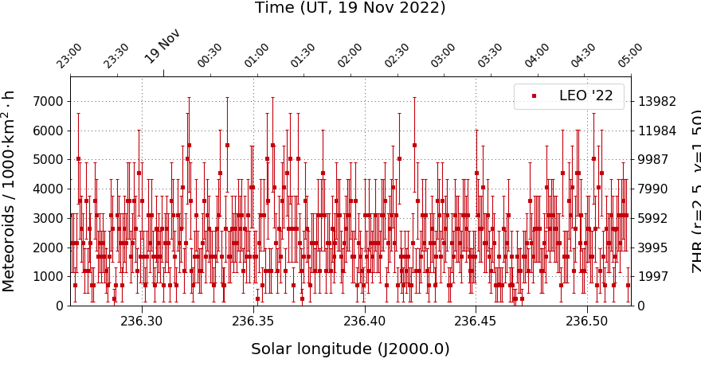
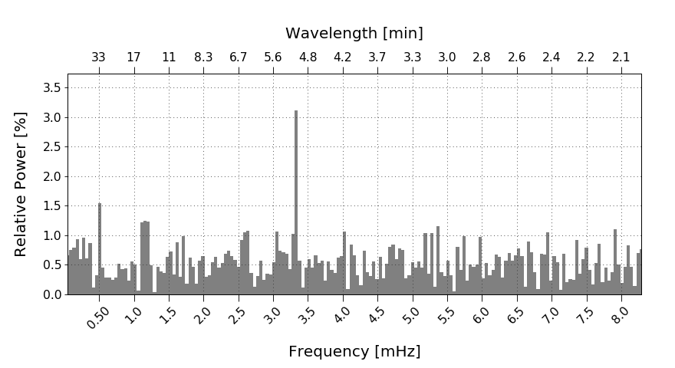
Simulation of Periodic Oscillations
Effect of wavelength: 5 min
Constant activity 3/min + Sine with 3/min and WL 5 min
Poisson-distribution random numbers
Flux density in MeteorFlux
Spectrogram in MeteorFlux
Changes in wavelength are clearly reflected.

Slide 12
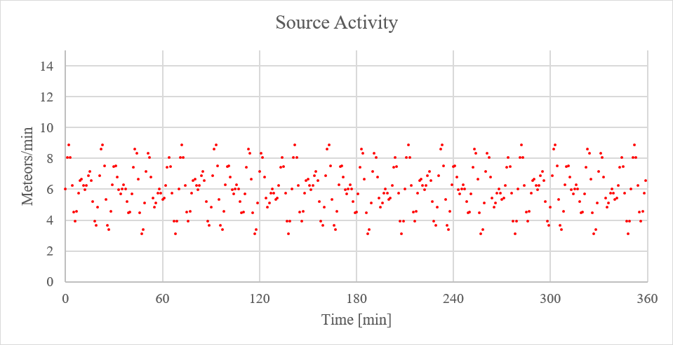
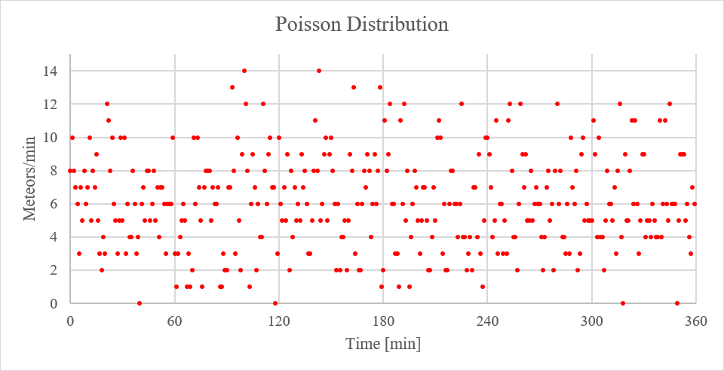
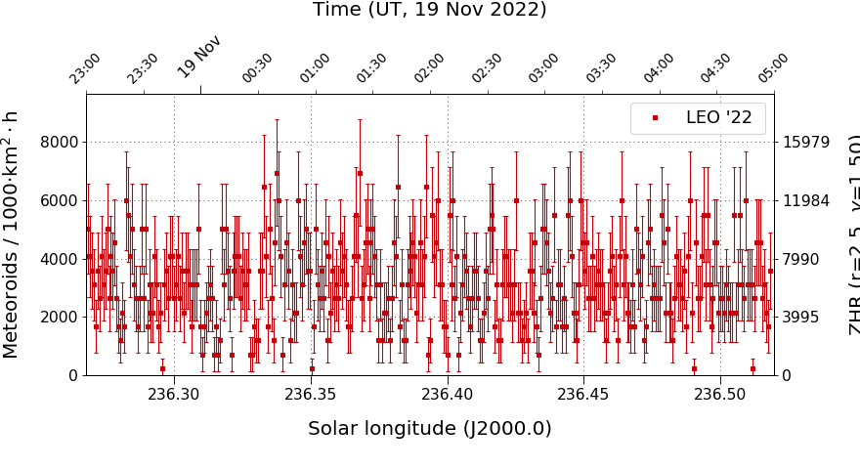
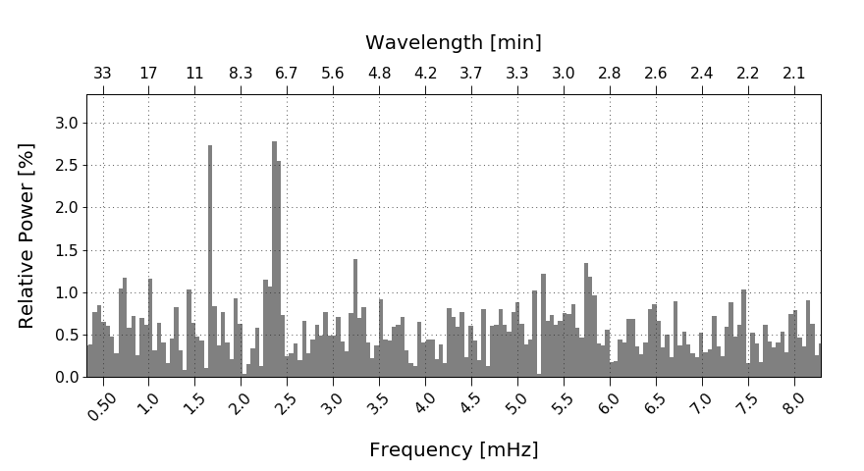
Simulation of Periodic Oscillations
Effect of wavelength mix: 7 min and 10 min
Constant activity 3/min + Sine with 3/min and WL 7 min + Sine with 3/min and WL 10 min
Poisson-distribution random numbers
Flux density in MeteorFlux
Spectrogram in MeteorFlux
Mixtures of frequencies can be separated.

Slide 13
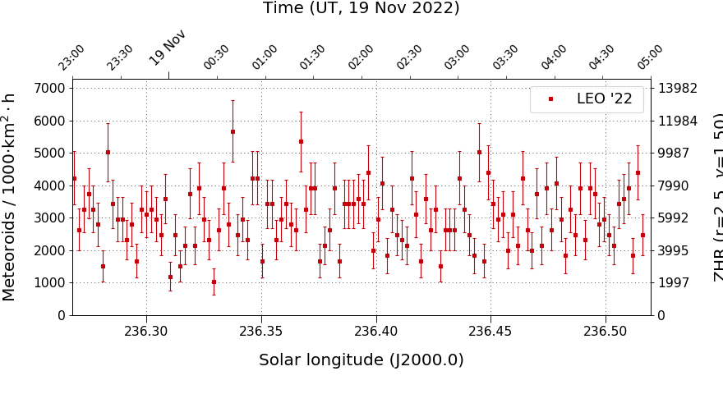
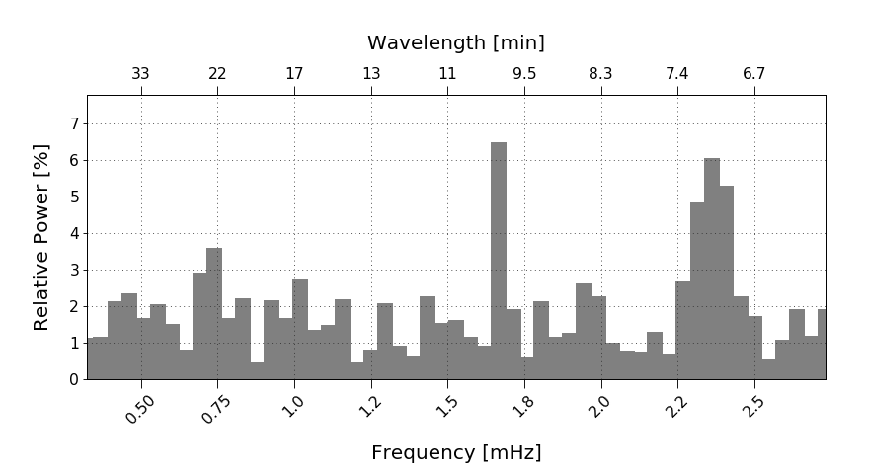
Simulation of Periodic Oscillations
Effect of binning: 3 min.
Constant activity 3/min + Sine with 3/min and WL 7 min + Sine with 3/min and WL 10 min
Poisson-distribution random numbers
Flux density in MeteorFlux
Spectrogram in MeteorFlux
Binning reduces the frequency resolution.

Slide 14
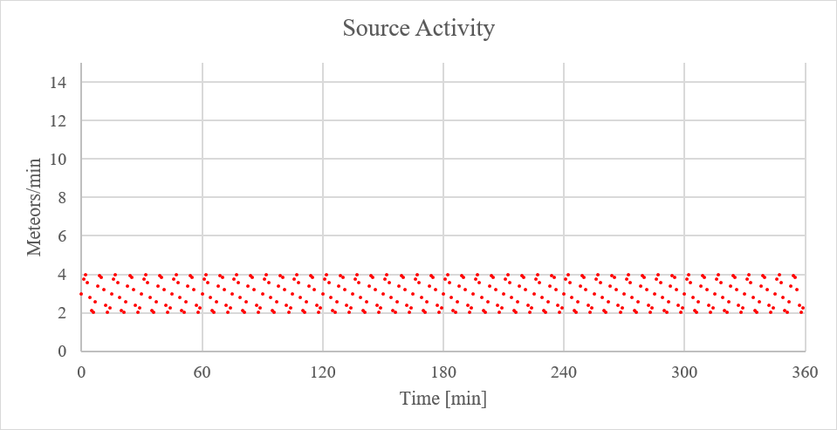
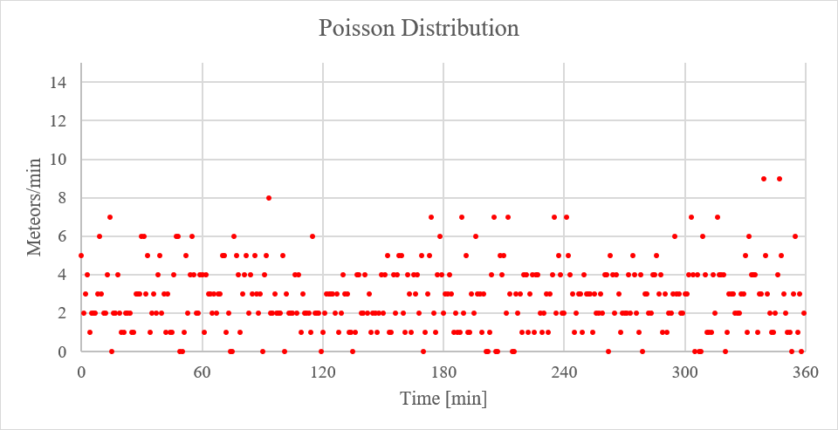
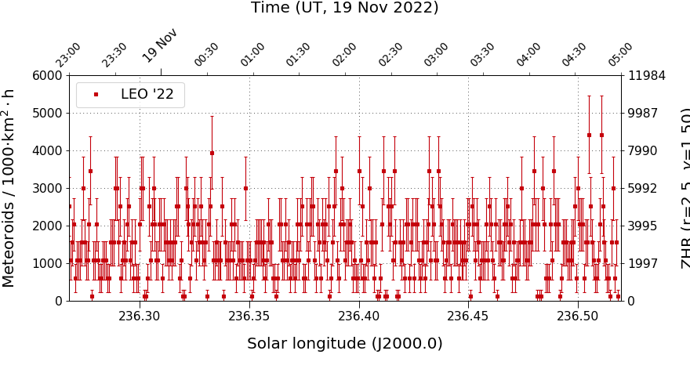
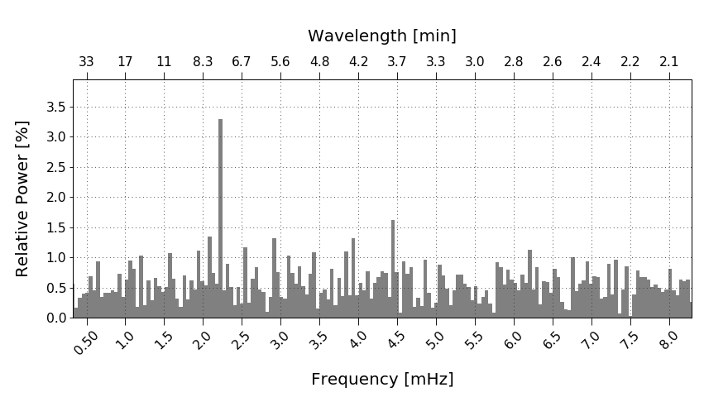
Simulation of Periodic Oscillations
Effect of signal strength: 2/min constant and 2/min periodic.
Constant activity with 2/min + Sine with 2/min and WL 7.5 min
Poisson-distribution random numbers
Flux density in MeteorFlux
Spectrogram in MeteorFlux
Lower signal strength reduces the SNR in the spectrogram.

Slide 15
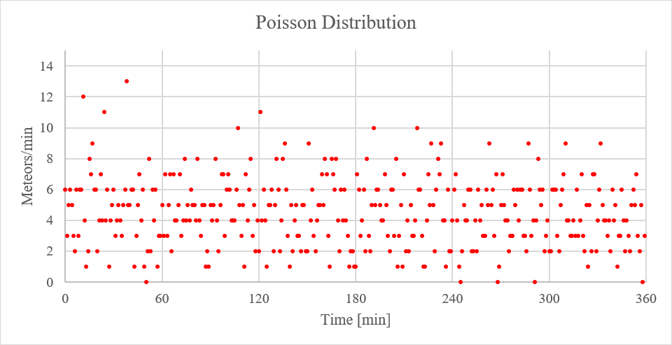
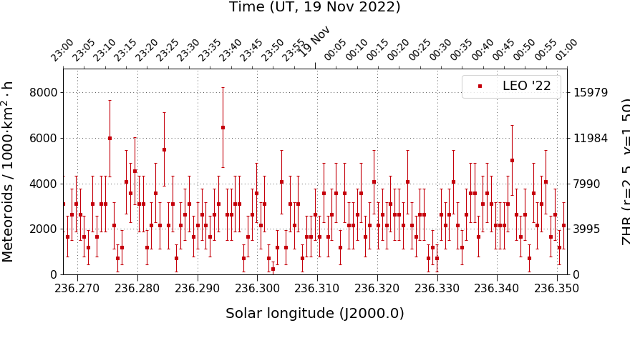
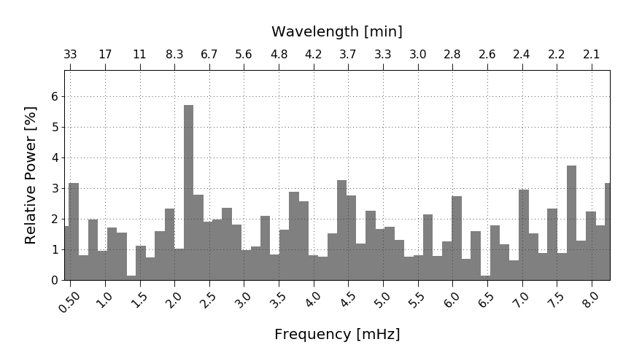
Simulation of Periodic Oscillations
Effect of length of observation: 2 hours
Constant activity 3/min + Sine with 3/min and WL 7.5 min, 2 hours
Poisson-distribution random numbers
Flux density in MeteorFlux
Spectrogram in MeteorFlux
Shorter observations reduce the frequency range and resolution.

Slide 16
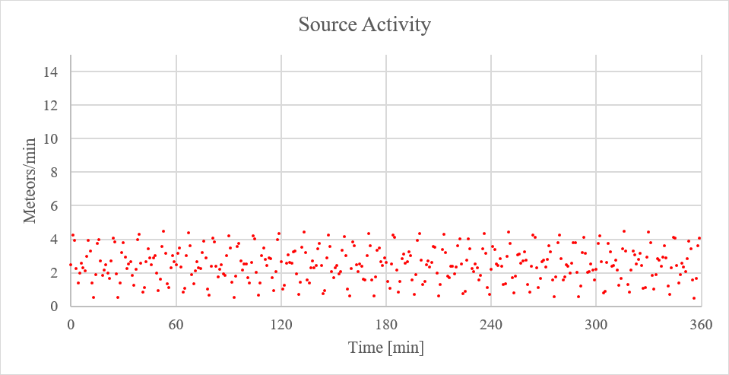
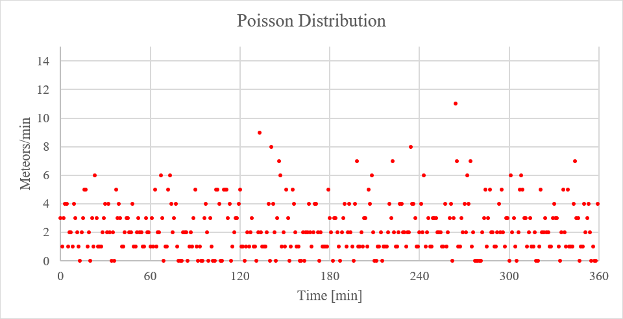
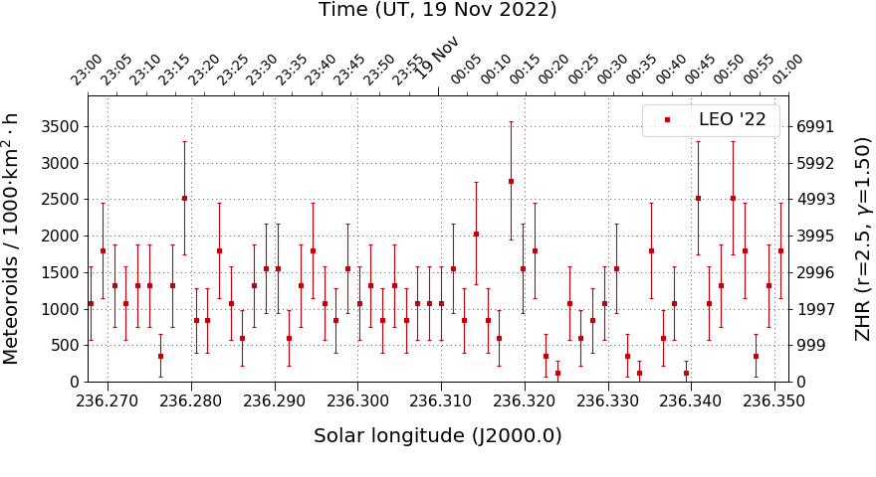
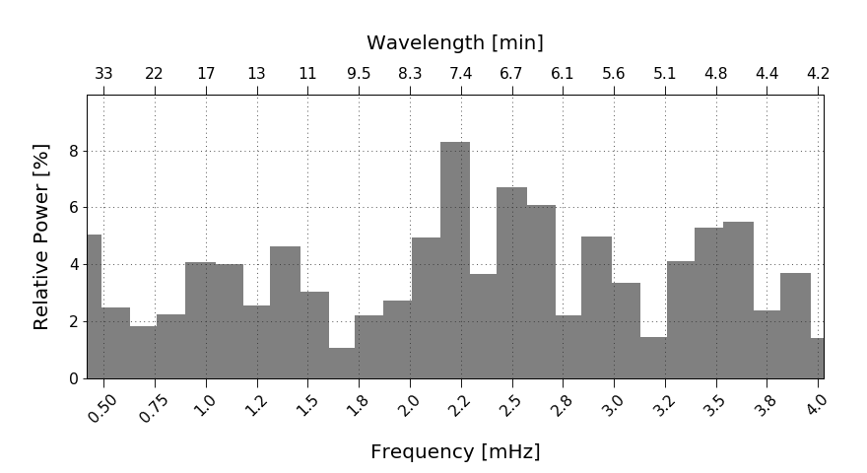
Simulation of Periodic Oscillations
Trying to simulate 1999 Leonids.
Constant activity 0.5/min + Sine with 2/min and WL 7.3 min + Sine with 2/min and WL 4.7 min, 2 hours
Poisson-distribution random numbers
Flux density in MeteorFlux
Spectrogram in MeteorFlux
Just a quick shot, no optimization.

Slide 17
Simulation of Periodic Oscillations
Simulation comes close to observation.
“Model”
Observation
Leonids 1999 seem to contain significant periodic signals, possibly with two frequencies or phase shift.
Quantitative results require Monte Carlo simulations.

Slide 18
Reference Limiting Magnitude
In a recent AAS paper, Moorhead et al is combining flux density measures from radar (CMOR), video (IMO Network, GMN) and visual (IMO) observations.
Two key problems are identified:
Networks use different population indices for the same shower.
All observations are normalized to a reference lm of 6.5 mag, often causing extrapolation over several magnitudes
Moorhead et al suggest that each team is normalizing their data to a network-specific reference magnitude equal to the weighted average lm of the network.
Extrapolation errors are reduced.
Normalization can be done later when network data are combined.

Slide 19
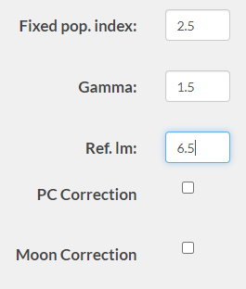
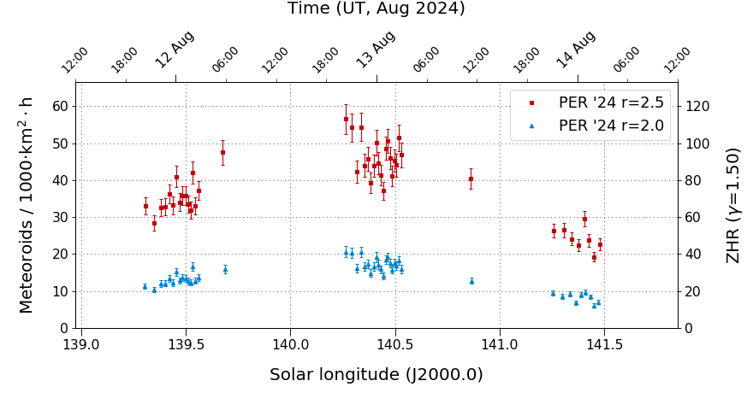
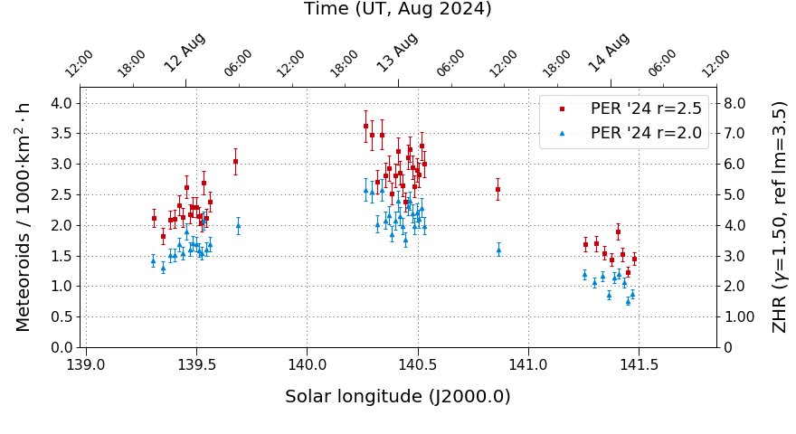
Reference Limiting Magnitude
A reference limiting magnitude was introduced in MeteorFlux.
The power exponent b is displayed in the resulting data table.
Researchers can transform MeteorFlux data from population index r_{old} to r_{new} with correction factor
CF = (r_{old}/r_{new})^{b}
Output of power exponent in data table
Reference lm configuration
Transforming from r=2.5 to r=2.0 with reference lm = 6.5 mag
Transforming from r=2.5 to r=2.0 with reference lm = 3.5 mag

Slide 20
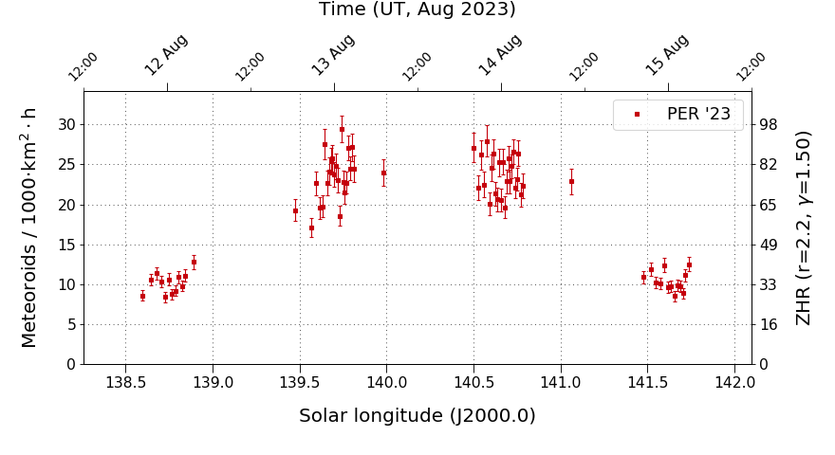
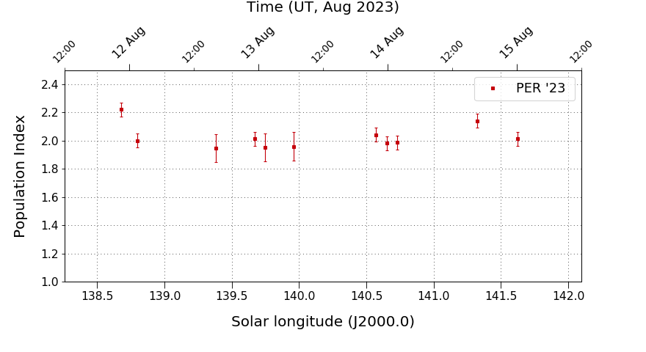
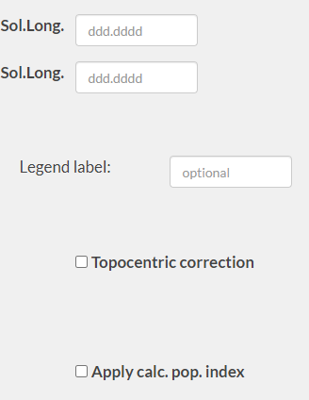
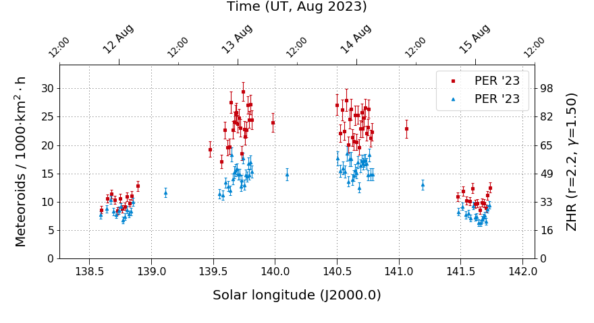
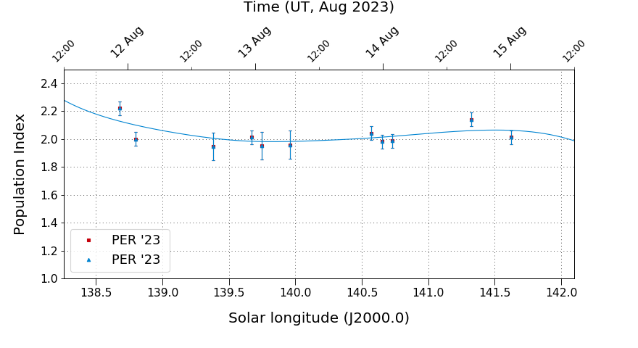
Application of Population Index
Flux densities and r-values could only be calculated separately.
r-graph can now be smoothed with a spline and applied directly to the flux density.
Flux density graph
Population index graph
Population index configuration
Flux density graph with fixed r=2.2 and with variable r-value
Population index graph and spline function for smoothing

Slide 21
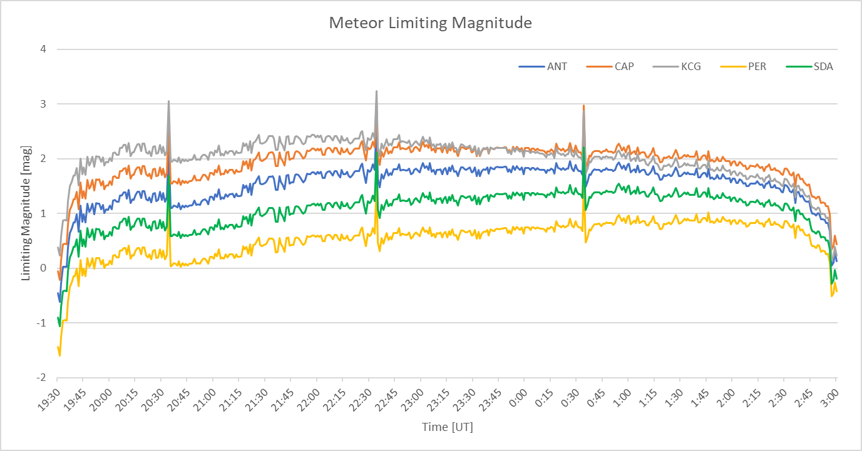
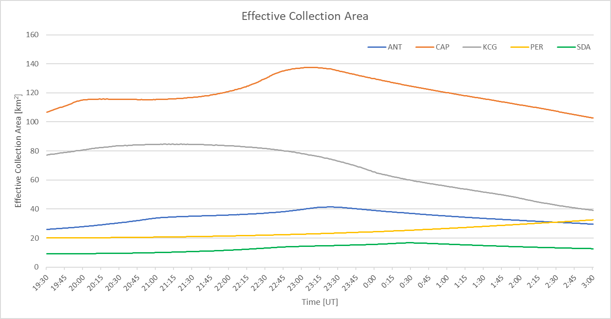
Integrating AllSky7 Observation
IMO Video Network cameras are primarily located in Europe.
Flux density graphs have gaps.
AllSky7 has about 1,500 single cameras deployed world-wide.
Integrating AllSky7 data will close the gaps and offer true 24/7 monitoring.
The integration is ongoing and ~75% finished.
First results expected before end of year.
Meteor lm for Cam7@AMS16 on August 12/13, 2024
Collection area for Cam7@AMS16 on August 12/13, 2024

Slide 22
The End
Thanks for your attention!
Questions?

